Slide 1
Style Transfer Implement
崔耘珩

Slide 2
Outline
Introduction of Style Transfer
Convolution Neural Network
Fei-Fei Li’s Style Transfer Model
Ours Style Transfer Model
Comparisons

Slide 3
Fei-Fei Li’s Model
Perceptual Losses for Real-Time Style Transfer and Super-Resolution

Slide 4
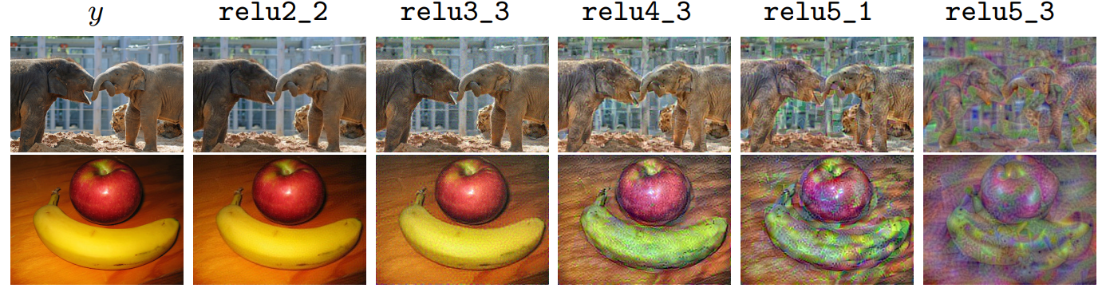
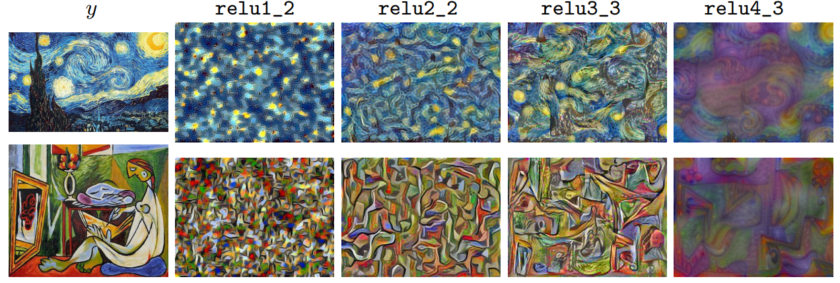
Introduction
Content Loss
Style Loss
Source: https://arxiv.org/pdf/1603.08155.pdf

Slide 5
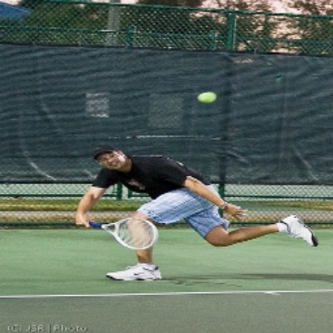
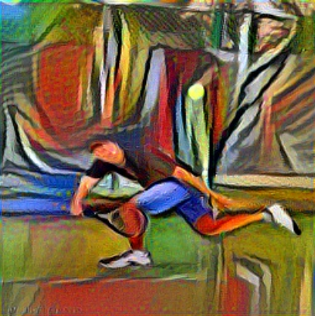
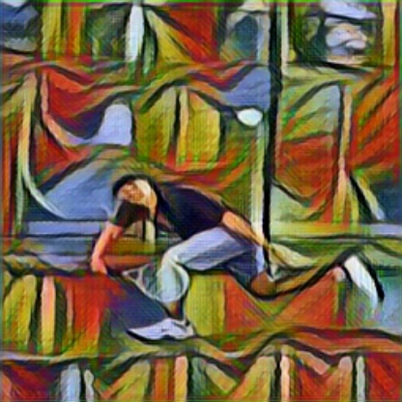
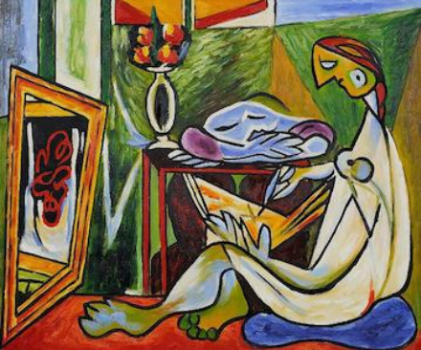
Perceptual Loss
Content
Per-pixel Loss
Perceptual Loss
Style
Gatys et al. (2015)
Fei-Fei Li (2016)
Source: https://arxiv.org/pdf/1603.08155.pdf

Slide 6
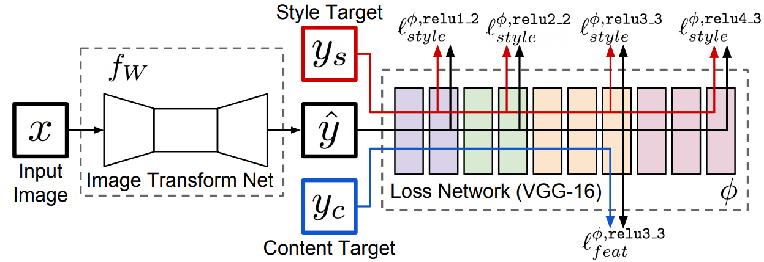
Architecture
Source: https://arxiv.org/pdf/1603.08155.pdf

Slide 7
Build Environment

Slide 8
Clone Files From The Github Repository
Python Version: 3.7.11
git clone https://github.com/pytorch/examples.git
Change directory to examples\fast_neural_style\
cd examples\fast_neural_style\

Slide 9
Install Requirements
pip install –r requirements.txt
requirements.txt
torchvision @ https://download.pytorch.org/whl/cu102/torchvision-0.10.0%2Bcu102-cp37-cp37m-linux_x86_64.whl torch @ https://download.pytorch.org/whl/cu102/torch-1.9.0%2Bcu102-cp37-cp37m-linux_x86_64.whl tensorflow @ file:///tensorflow-2.5.0-cp37-cp37m-linux_x86_64.whl tensorboard==2.5.0 keras==2.4.3 scipy==1.4.1 numpy==1.19.5

Slide 10
Preprocessing Datasets
Create dataset folder.
md dataset
Download dataset. (COCO 2014 Training images dataset)
curl -O http://images.cocodataset.org/zips/train2014.zip
Unzip dataset
unzip train2014.zip –d dataset\

Slide 11
Train the Model
python3 neural_style/neural_style.py train --dataset </path/to/train-dataset> \ --style-image </path/to/style/image> \ --save-model-dir </path/to/save-model/folder> \ --checkpoint-model-dir </path/to/save-model/folder> \ --checkpoint-interval 500 \ --content-weight 10e4 \ --epochs 2 \ --cuda 1
--dataset: Path to training dataset.
--style-image: Path to style-image.
--save-model-dir: Path to save the trained model.
--checkpoint-model-dir: Path to save the checkpoints.
--checkpoint-interval: Number of batches after which a checkpoint of the trained model will be created.
--content-weight: Weight for content-loss.
--epochs: Number of training epochs.
--cuda: Set it to 1 for running on GPU, 0 for CPU.

Slide 12
Evaluate the Model
python3 neural_style/neural_style.py eval --content-image </path/to/content/image> \ --model </path/to/saved/model> \ --output-image </path/to/output/image> \ --cuda 0
--content-image: Path to content images.
--model: Saved models or checkpoints to be used for stylizing the image.
--output-image: Path for saving the output image.
--cuda: Set it to 1 for running on GPU, 0 for CPU.

Slide 13
Code

Slide 14
Import Modules
neural_style.py
import argparse import os import sys import time import re import numpy as np import torch from torch.optim import Adam from torch.utils.data import DataLoader from torchvision import datasets from torchvision import transforms import torch.onnx import utils from transformer_net import TransformerNet from vgg import Vgg16

Slide 15
Check Paths Function
def check_paths(args): try: if not os.path.exists(args.save_model_dir): os.makedirs(args.save_model_dir) if args.checkpoint_model_dir is not None and not (os.path.exists(args.checkpoint_model_dir)): os.makedirs(args.checkpoint_model_dir) except OSError as e: print(e) sys.exit(1)

Slide 16
Function of Training Model (1/8)
def train(args): # Use CUDA or CPU to train the model. device = torch.device("cuda" if args.cuda else "cpu") # Set random seed. np.random.seed(args.seed) torch.manual_seed(args.seed) transform = transforms.Compose([ # Resize and crop image. transforms.Resize(args.image_size), transforms.CenterCrop(args.image_size), # Change the image representation from array to float32. transforms.ToTensor(), transforms.Lambda(lambda x: x.mul(255)) ])

Slide 17
Function of Training Model (2/8)
# Load train dataset. train_dataset = datasets.ImageFolder(args.dataset, transform) train_loader = DataLoader(train_dataset, batch_size=args.batch_size) # Import Transform Network. transformer = TransformerNet().to(device) # Import loss function. optimizer = Adam(transformer.parameters(), args.lr) mse_loss = torch.nn.MSELoss() # Use VGG16 architecture as Loss Network. vgg = Vgg16(requires_grad=False).to(device) style_transform = transforms.Compose([ transforms.ToTensor(), transforms.Lambda(lambda x: x.mul(255)) ])

Slide 18
Function of Training Model (3/8)
# Import the style image. style = utils.load_image(args.style_image, size=args.style_size) # Transfer feature of style image. style = style_transform(style) style = style.repeat(args.batch_size, 1, 1, 1).to(device) # Calculate style loss of style image. features_style = vgg(utils.normalize_batch(style)) gram_style = [utils.gram_matrix(y) for y in features_style]

Slide 19
Function of Training Model (4/8)
# Training for optimize model. for e in range(args.epochs): transformer.train() agg_content_loss = 0. agg_style_loss = 0. count = 0

Slide 20
Function of Training Model (5/8)
# Extract features from content image. for batch_id, (x, _) in enumerate(train_loader): n_batch = len(x) count += n_batch optimizer.zero_grad() # Construct a network on CPU or GPU. x = x.to(device) y = transformer(x) # Normalize layer. y = utils.normalize_batch(y) x = utils.normalize_batch(x) # Extract image features. features_y = vgg(y) features_x = vgg(x) # Calculate content loss and content weight of content image. content_loss = args.content_weight * mse_loss(features_y.relu2_2, features_x.relu2_2) style_loss = 0.

Slide 21
Function of Training Model (6/8)
# Training for optimize model. for ft_y, gm_s in zip(features_y, gram_style): gm_y = utils.gram_matrix(ft_y) style_loss += mse_loss(gm_y, gm_s[:n_batch, :, :]) style_loss *= args.style_weight total_loss = content_loss + style_loss total_loss.backward() optimizer.step() agg_content_loss += content_loss.item() agg_style_loss += style_loss.item()

Slide 22
Function of Training Model (7/8)
if (batch_id + 1) % args.log_interval == 0: mesg = "{}\tEpoch {}:\t[{}/{}]\tcontent: {:.6f}\tstyle: {:.6f}\ttotal: {:.6f}".format( time.ctime(), e + 1, count, len(train_dataset), agg_content_loss / (batch_id + 1), agg_style_loss / (batch_id + 1), (agg_content_loss + agg_style_loss) / (batch_id + 1) ) print(mesg)
if args.checkpoint_model_dir is not None and (batch_id + 1) % args.checkpoint_interval == 0: transformer.eval().cpu() ckpt_model_filename = "ckpt_epoch_" + str(e) + "_batch_id_" + str(batch_id + 1) + ".pth" ckpt_model_path = os.path.join(args.checkpoint_model_dir, ckpt_model_filename) torch.save(transformer.state_dict(), ckpt_model_path) transformer.to(device).train()

Slide 23
Function of Training Model (8/8)
# Save model. transformer.eval().cpu() save_model_filename = "epoch_" + str(args.epochs) + "_" + str(time.ctime()).replace(' ', '_') + "_" + str( args.content_weight) + "_" + str(args.style_weight) + ".model" save_model_path = os.path.join(args.save_model_dir, save_model_filename) torch.save(transformer.state_dict(), save_model_path) print("\nDone, trained model saved at", save_model_path)

Slide 24
Function of Stylize Image.
def stylize(args): # Use CUDA or CPU to stylize the image. device = torch.device("cuda" if args.cuda else "cpu") # Import the content image. content_image = utils.load_image(args.content_image, scale=args.content_scale) content_transform = transforms.Compose([ transforms.ToTensor(), transforms.Lambda(lambda x: x.mul(255)) ]) # Load the content image to the Network. content_image = content_transform(content_image) content_image = content_image.unsqueeze(0).to(device)

Slide 25
Argument Parsers (1/4)
def main(): main_arg_parser = argparse.ArgumentParser(description="parser for fast-neural-style") subparsers = main_arg_parser.add_subparsers(title="subcommands", dest="subcommand") train_arg_parser = subparsers.add_parser("train", help="parser for training arguments") train_arg_parser.add_argument("--epochs", type=int, default=2, help="number of training epochs, default is 2") train_arg_parser.add_argument("--batch-size", type=int, default=4, help="batch size for training, default is 4") train_arg_parser.add_argument("--dataset", type=str, required=True, help="path to training dataset, the path should point to a folder " "containing another folder with all the training images") train_arg_parser.add_argument("--style-image", type=str, default="images/style-images/mosaic.jpg", help="path to style-image") train_arg_parser.add_argument("--save-model-dir", type=str, required=True, help="path to folder where trained model will be saved.") train_arg_parser.add_argument("--checkpoint-model-dir", type=str, default=None, help="path to folder where checkpoints of trained models will be saved")

Slide 26
Argument Parsers (2/4)
train_arg_parser.add_argument("--image-size", type=int, default=256, help="size of training images, default is 256 X 256") train_arg_parser.add_argument("--style-size", type=int, default=None, help="size of style-image, default is the original size of style image") train_arg_parser.add_argument("--cuda", type=int, required=True, help="set it to 1 for running on GPU, 0 for CPU") train_arg_parser.add_argument("--seed", type=int, default=42, help="random seed for training") train_arg_parser.add_argument("--content-weight", type=float, default=1e5, help="weight for content-loss, default is 1e5") train_arg_parser.add_argument("--style-weight", type=float, default=1e10, help="weight for style-loss, default is 1e10") train_arg_parser.add_argument("--lr", type=float, default=1e-3, help="learning rate, default is 1e-3") train_arg_parser.add_argument("--log-interval", type=int, default=500, help="number of images after which the training loss is logged, default is 500") train_arg_parser.add_argument("--checkpoint-interval", type=int, default=2000, help="number of batches after which a checkpoint of the trained model will be created")

Slide 27
Argument Parsers (3/4)
eval_arg_parser = subparsers.add_parser("eval", help="parser for evaluation/stylizing arguments") eval_arg_parser.add_argument("--content-image", type=str, required=True, help="path to content image you want to stylize") eval_arg_parser.add_argument("--content-scale", type=float, default=None, help="factor for scaling down the content image") eval_arg_parser.add_argument("--output-image", type=str, required=True, help="path for saving the output image") eval_arg_parser.add_argument("--model", type=str, required=True, help="saved model to be used for stylizing the image. If file ends in .pth - PyTorch path is used, if in .onnx - Caffe2 path") eval_arg_parser.add_argument("--cuda", type=int, required=True, help="set it to 1 for running on GPU, 0 for CPU") eval_arg_parser.add_argument("--export_onnx", type=str, help="export ONNX model to a given file")

Slide 28
Argument Parsers (4/4)
args = main_arg_parser.parse_args() if args.subcommand is None: print("ERROR: specify either train or eval") sys.exit(1) if args.cuda and not torch.cuda.is_available(): print("ERROR: cuda is not available, try running on CPU") sys.exit(1) if args.subcommand == "train": check_paths(args) train(args) else: stylize(args) if __name__ == "__main__": main()

Slide 29
VGG16 Architecture (1/2)
vgg.py
from collections import namedtuple import torch from torchvision import models class Vgg16(torch.nn.Module): def __init__(self, requires_grad=False): super(Vgg16, self).__init__() vgg_pretrained_features = models.vgg16(pretrained=True).features # Build sequential modules. self.slice1 = torch.nn.Sequential() self.slice2 = torch.nn.Sequential() self.slice3 = torch.nn.Sequential() self.slice4 = torch.nn.Sequential() for x in range(4): self.slice1.add_module(str(x), vgg_pretrained_features[x]) for x in range(4, 9): self.slice2.add_module(str(x), vgg_pretrained_features[x]) for x in range(9, 16): self.slice3.add_module(str(x), vgg_pretrained_features[x]) for x in range(16, 23): self.slice4.add_module(str(x), vgg_pretrained_features[x]) if not requires_grad: for param in self.parameters(): param.requires_grad = False

Slide 30
VGG16 Architecture (2/2)
vgg.py
def forward(self, X): h = self.slice1(X) h_relu1_2 = h h = self.slice2(h) h_relu2_2 = h h = self.slice3(h) h_relu3_3 = h h = self.slice4(h) h_relu4_3 = h vgg_outputs = namedtuple("VggOutputs", ['relu1_2', 'relu2_2', 'relu3_3', 'relu4_3']) out = vgg_outputs(h_relu1_2, h_relu2_2, h_relu3_3, h_relu4_3) return out

Slide 31
Utils (1/2)
utils.py
import torch from PIL import Image # Function of load image. def load_image(filename, size=None, scale=None): img = Image.open(filename).convert('RGB') if size is not None: img = img.resize((size, size), Image.ANTIALIAS) elif scale is not None: img = img.resize((int(img.size[0] / scale), int(img.size[1] / scale)), Image.ANTIALIAS) return img # Function of save image. def save_image(filename, data): img = data.clone().clamp(0, 255).numpy() img = img.transpose(1, 2, 0).astype("uint8") img = Image.fromarray(img) img.save(filename)

Slide 32
Utils (2/2)
utils.py
# Gram matrix function. def gram_matrix(y): (b, ch, h, w) = y.size() features = y.view(b, ch, w * h) features_t = features.transpose(1, 2) gram = features.bmm(features_t) / (ch * h * w) return gram def normalize_batch(batch): # Normalize using imagenet mean and std. mean = batch.new_tensor([0.485, 0.456, 0.406]).view(-1, 1, 1) std = batch.new_tensor([0.229, 0.224, 0.225]).view(-1, 1, 1) batch = batch.div_(255.0) return (batch - mean) / std

Slide 33
Image Transform Network (1/5)
transformer_net.py
import torch # Define style transfer network. class TransformerNet(torch.nn.Module): def __init__(self): super(TransformerNet, self).__init__() # Initial convolution layers. self.conv1 = ConvLayer(3, 32, kernel_size=9, stride=1) self.in1 = torch.nn.InstanceNorm2d(32, affine=True) self.conv2 = ConvLayer(32, 64, kernel_size=3, stride=2) self.in2 = torch.nn.InstanceNorm2d(64, affine=True) self.conv3 = ConvLayer(64, 128, kernel_size=3, stride=2) self.in3 = torch.nn.InstanceNorm2d(128, affine=True) # Build residual layers. self.res1 = ResidualBlock(128) self.res2 = ResidualBlock(128) self.res3 = ResidualBlock(128) self.res4 = ResidualBlock(128) self.res5 = ResidualBlock(128)

Slide 34
Image Transform Network (2/5)
transformer_net.py
# Build upsampling layers. self.deconv1 = UpsampleConvLayer(128, 64, kernel_size=3, stride=1, upsample=2) self.in4 = torch.nn.InstanceNorm2d(64, affine=True) self.deconv2 = UpsampleConvLayer(64, 32, kernel_size=3, stride=1, upsample=2) self.in5 = torch.nn.InstanceNorm2d(32, affine=True) self.deconv3 = ConvLayer(32, 3, kernel_size=9, stride=1) # Use Rectified Linear Unit (ReLU) for activation function. self.relu = torch.nn.ReLU() # Define forward propagation network. def forward(self, X): y = self.relu(self.in1(self.conv1(X))) y = self.relu(self.in2(self.conv2(y))) y = self.relu(self.in3(self.conv3(y))) y = self.res1(y) y = self.res2(y) y = self.res3(y) y = self.res4(y) y = self.res5(y) y = self.relu(self.in4(self.deconv1(y))) y = self.relu(self.in5(self.deconv2(y))) y = self.deconv3(y) return y
# Build upsampling layers. self.deconv1 = UpsampleConvLayer(128, 64, kernel_size=3, stride=1, upsample=2) self.in4 = torch.nn.InstanceNorm2d(64, affine=True) self.deconv2 = UpsampleConvLayer(64, 32, kernel_size=3, stride=1, upsample=2) self.in5 = torch.nn.InstanceNorm2d(32, affine=True) self.deconv3 = ConvLayer(32, 3, kernel_size=9, stride=1) # Use Rectified Linear Unit (ReLU) for activation function. self.relu = torch.nn.ReLU() # Define forward propagation network. def forward(self, X): y = self.relu(self.in1(self.conv1(X))) y = self.relu(self.in2(self.conv2(y))) y = self.relu(self.in3(self.conv3(y))) y = self.res1(y) y = self.res2(y) y = self.res3(y) y = self.res4(y) y = self.res5(y) y = self.relu(self.in4(self.deconv1(y))) y = self.relu(self.in5(self.deconv2(y))) y = self.deconv3(y) return y
# Build upsampling layers. self.deconv1 = UpsampleConvLayer(128, 64, kernel_size=3, stride=1, upsample=2) self.in4 = torch.nn.InstanceNorm2d(64, affine=True) self.deconv2 = UpsampleConvLayer(64, 32, kernel_size=3, stride=1, upsample=2) self.in5 = torch.nn.InstanceNorm2d(32, affine=True) self.deconv3 = ConvLayer(32, 3, kernel_size=9, stride=1) # Use Rectified Linear Unit (ReLU) for activation function. self.relu = torch.nn.ReLU() # Define forward propagation network. def forward(self, X): y = self.relu(self.in1(self.conv1(X))) y = self.relu(self.in2(self.conv2(y))) y = self.relu(self.in3(self.conv3(y))) y = self.res1(y) y = self.res2(y) y = self.res3(y) y = self.res4(y) y = self.res5(y) y = self.relu(self.in4(self.deconv1(y))) y = self.relu(self.in5(self.deconv2(y))) y = self.deconv3(y) return y
# Build upsampling layers. self.deconv1 = UpsampleConvLayer(128, 64, kernel_size=3, stride=1, upsample=2) self.in4 = torch.nn.InstanceNorm2d(64, affine=True) self.deconv2 = UpsampleConvLayer(64, 32, kernel_size=3, stride=1, upsample=2) self.in5 = torch.nn.InstanceNorm2d(32, affine=True) self.deconv3 = ConvLayer(32, 3, kernel_size=9, stride=1) # Use Rectified Linear Unit (ReLU) for activation function. self.relu = torch.nn.ReLU() # Define forward propagation network. def forward(self, X): y = self.relu(self.in1(self.conv1(X))) y = self.relu(self.in2(self.conv2(y))) y = self.relu(self.in3(self.conv3(y))) y = self.res1(y) y = self.res2(y) y = self.res3(y) y = self.res4(y) y = self.res5(y) y = self.relu(self.in4(self.deconv1(y))) y = self.relu(self.in5(self.deconv2(y))) y = self.deconv3(y) return y

Slide 35
Image Transform Network (3/5)
# Define convolution layers. class ConvLayer(torch.nn.Module): def __init__(self, in_channels, out_channels, kernel_size, stride): super(ConvLayer, self).__init__() # Set reflection padding size. reflection_padding = kernel_size // 2 self.reflection_pad = torch.nn.ReflectionPad2d(reflection_padding) self.conv2d = torch.nn.Conv2d(in_channels, out_channels, kernel_size, stride) # Define forward propagation network. def forward(self, x): out = self.reflection_pad(x) out = self.conv2d(out) return out

Slide 36
Image Transform Network (4/5)
# Define residual blocks. class ResidualBlock(torch.nn.Module): def __init__(self, channels): super(ResidualBlock, self).__init__() # Construct network with convolution layers and normalize layers. self.conv1 = ConvLayer(channels, channels, kernel_size=3, stride=1) self.in1 = torch.nn.InstanceNorm2d(channels, affine=True) self.conv2 = ConvLayer(channels, channels, kernel_size=3, stride=1) self.in2 = torch.nn.InstanceNorm2d(channels, affine=True) # Use Rectified Linear Unit (ReLU) for activation function. self.relu = torch.nn.ReLU() # Define forward propagation network. def forward(self, x): residual = x out = self.relu(self.in1(self.conv1(x))) out = self.in2(self.conv2(out)) out = out + residual return out

Slide 37
Image Transform Network (5/5)
# Define upsampling layers. class UpsampleConvLayer(torch.nn.Module): def __init__(self, in_channels, out_channels, kernel_size, stride, upsample=None): super(UpsampleConvLayer, self).__init__() self.upsample = upsample reflection_padding = kernel_size // 2 self.reflection_pad = torch.nn.ReflectionPad2d(reflection_padding) self.conv2d = torch.nn.Conv2d(in_channels, out_channels, kernel_size, stride) # Define forward propagation network. def forward(self, x): x_in = x if self.upsample: x_in = torch.nn.functional.interpolate(x_in, mode='nearest', scale_factor=self.upsample) out = self.reflection_pad(x_in) out = self.conv2d(out) return out

Slide 38
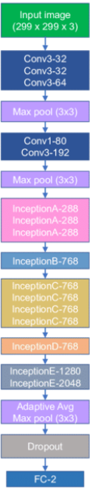
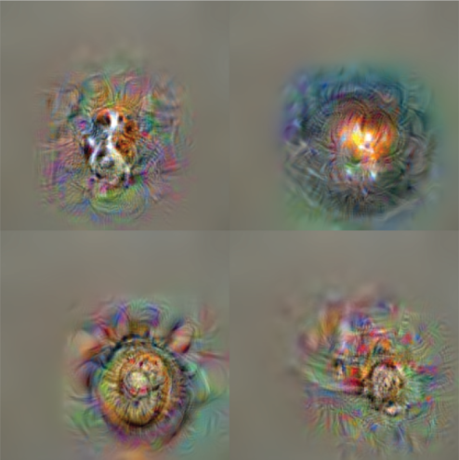
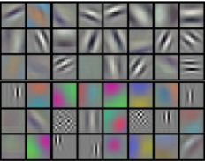
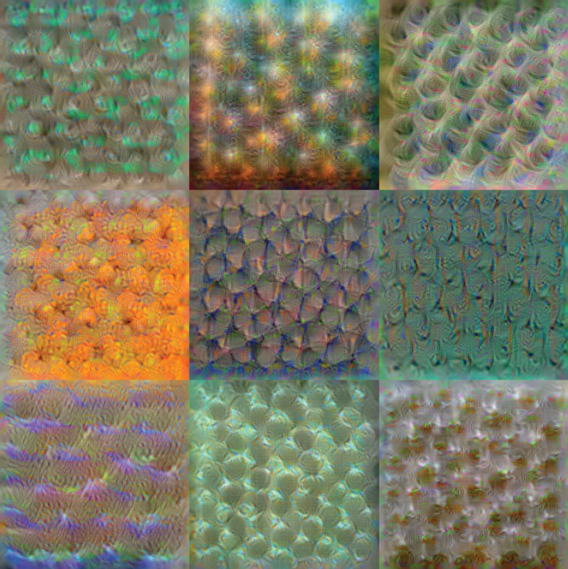
Inception v3 Network
Datasets
Prediction
Edge + blob
Texture
Object Parts
Source: http://vision03.csail.mit.edu/cnn_art/index.html
Source: https://www.researchgate.net/figure/CNN-architectures-of-a-Inception-v3-b-Inception-v4-c-Inception-ResNet-v2-d_fig3_345313795

Slide 39
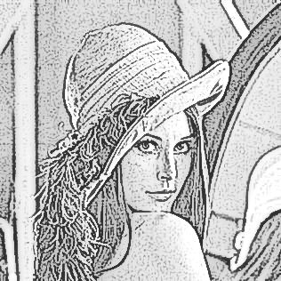
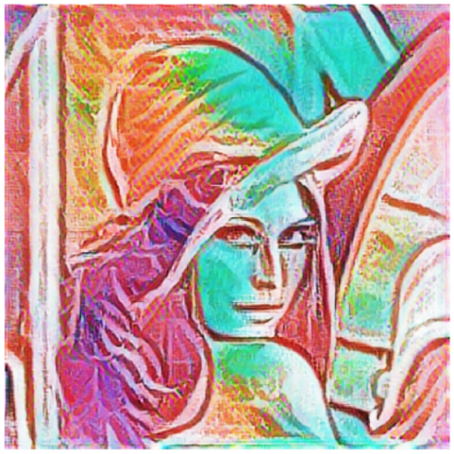
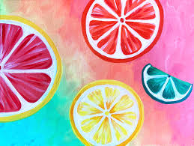
Steps of Style Transfer
Calculate features for content image and style image.
Randomly generate new output image.
Calculate style loss and content loss of output image.
Use gradient descent to optimize output image.
GOTO step 2.
Content Image
Output Image
Trained Transfer Network
Trained Prediction Network
Style Image
Loss
Network

Slide 40
Build Environment

Slide 41
Build Environment
Python Version: 3.8.9
Create log, datasets, and checkpoints directory.
md log datasets\train datasets\val datasets\style checkpoints
Download and Unpack Pre-trained Networks.
Download VGG16 Pre-trained Network.
curl -o checkpoints\vgg_16_2016_08_28.tar.gz http://download.tensorflow.org/models/vgg_16_2016_08_28.tar.gz
Download Inception V3 Pre-trained Network.
curl -L "https://docs.google.com/uc?export=download&id=1H1X_dplTNwWXb2N_1Ji5HnqXKgj2cp2t" > checkpoints\Inception_v3_224.tgz
Unpack VGG16 Pre-trained Network.
tar zxvf checkpoints\vgg_16_2016_08_28.tar.gz –C checkpoints\
Unpack Inception V3 Pre-trained Network.
tar zxvf checkpoints\Inception_v3_224.tgz –C checkpoints\

Slide 42
Datasets Preprocessing
Download Datasets.
Tiny ImageNet dataset.
https://downgit.github.io/#/home?url=https://github.com/t106368073/Style-Transfer/tree/main/TinyImageNetDataset
Style dataset.
https://docs.google.com/uc?export=download&id=1bK37Qx8jp2ax_ZPTGpc4iZvlb7tytwwa
Unpack Tiny ImageNet dataset.
Unzip TinyImageNetDataset.zip

Slide 43
Install Requirements
pip install –r requirements.txt
requirements.txt
torchvision @ https://download.pytorch.org/whl/cu102/torchvision-0.10.0%2Bcu102-cp37-cp37m-linux_x86_64.whl torch @ https://download.pytorch.org/whl/cu102/torch-1.9.0%2Bcu102-cp37-cp37m-linux_x86_64.whl tensorflow @ file:///tensorflow-2.5.0-cp37-cp37m-linux_x86_64.whl tensorboard==2.5.0 keras==2.4.3 scipy==1.4.1 numpy==1.19.5 magenta==2.1.3 numba==0.48.0

Slide 44
Install slim Module
Clone Tensorflow models repository to install slim module.
git clone https://github.com/tensorflow/models.git
Change directory to folder models.
cd models
Change directory to folder slim.
cd models\research\slim
Install slim module.
python3 setup.py build python3 setup.py install

Slide 45
Train and Evaluate the Model
Train the model, output trained model.
python3 train.py --imagenet_data_dir=<PREPROCESSED_DATASETS_DIRECTORY>
Convert the trained model, will output 2 models: predict.tflite and transfer.tflite.
python3 convert.py --imagenet_data_dir=<PREPROCESSED_DATASETS_DIRECTORY>
Evaluate the model.
python3 eval.py

Slide 46
Code

Slide 47
Train
Import modules.
train.py
import ast import os from magenta.models.arbitrary_image_stylization import arbitrary_image_stylization_build_mobilenet_model as build_mobilenet_model from magenta.models.image_stylization import image_utils import tensorflow.compat.v1 as tf import tf_slim as slim

Slide 48
Define Directories
vgg_checkpoint = 'vgg16/vgg_16.ckpt' style_dataset_file = 'datasets/dtd_cobwebbed.tfrecord' inceptionv3_checkpoint = 'checkpoints/Inception_v3_224.ckpt' model_output = 'model_outputs'

Slide 49
Function to Process Input Images (1/2)
def main(unused_argv=None): tf.logging.set_verbosity(tf.logging.INFO) with tf.Graph().as_default(): # Let all input processing on the CPU, and training processing on the GPU. device = '/cpu:0' if not 0 else '/job:worker/cpu:0' with tf.device( tf.train.replica_device_setter(0, worker_device=device)): # Loads content images, batch size is 8, and content image size is 256*256 pixel. content_inputs_, _ = image_utils.imagenet_inputs(8, 256)

Slide 50
Function to Process Input Images (2/2)
# Loads style images. [style_inputs_, _, _] = image_utils.arbitrary_style_image_inputs( # Style dataset file. style_dataset_file, batch_size=8, image_size=256, # To shuffle style files at random. shuffle=True, # Crop the style image to 256*256 pixel. center_crop=False, # Resize the style images to a random size. augment_style_images=True, random_style_image_size=True)

Slide 51
Function to Define Content Weight and Style Weight
with tf.device(tf.train.replica_device_setter(0)): # Process content weight and style weight. content_weights = ast.literal_eval(default_content_weights) style_weights = ast.literal_eval(default_style_weights)

Slide 52
Function to Define the Model
stylized_images, total_loss, loss_dict, \ _ = build_mobilenet_model.build_mobilenet_model( # build content and style input tensor. content_inputs_, style_inputs_, # Set network parameters cannot be trained. mobilenet_trainable=False, # Set style and style transfer network parameters can be trained. style_params_trainable=True, transformer_trainable=True, # Set the endpoint to construct the style predict network. mobilenet_end_point='layer_19', # Reduce the number of filters in the model. transformer_alpha=0.25, style_prediction_bottleneck=100, # Add objectives to the model. adds_losses=True, content_weights=content_weights, style_weights=style_weights, total_variation_weight=1e4, )

Slide 53
Training Setup
# Adding scalar summaries to the tensorboard. for key, value in loss_dict.items(): tf.summary.scalar(key, value) # Adding Image summaries to the tensorboard. tf.summary.image('image/0_content_inputs', content_inputs_, 3) tf.summary.image('image/1_style_inputs_aug', style_inputs_, 3) tf.summary.image('image/2_stylized_images', stylized_images, 3)
# Set learning rate to 1e-5. optimizer = tf.train.AdamOptimizer(1e-5) # Define train optimizer. train_op = slim.learning.create_train_op( total_loss, optimizer, clip_gradient_norm=0, summarize_gradients=False)

Slide 54
Function to Load Checkpoints
# Function to load VGG16 parameters. init_fn_vgg = slim.assign_from_checkpoint_fn(os.path.expanduser(vgg_checkpoint), slim.get_variables('vgg_16')) # Function to load Inception V3 parameters. mobilenet_variables_dict = { var.op.name: var for var in slim.get_model_variables('MobilenetV2') } init_fn_mobilenet = slim.assign_from_checkpoint_fn( inceptionv3_checkpoint, mobilenet_variables_dict) # Function to restore VGG16 and Inception V3 parameters. def init_sub_networks(session): init_fn_vgg(session) init_fn_mobilenet(session)

Slide 55
Function to Build the Model
slim.learning.train( train_op=train_op, # Define log directory. logdir=os.path.expanduser(model_output), # Define address of the tensorflow master. master='', is_chief=0 == 0, # Define training steps. number_of_steps=800000, init_fn=init_sub_networks, # Save summaries every 15 seconds. save_summaries_secs=15, # Save model every 15 seconds. save_interval_secs=15)

Slide 56
Entry Point
def console_entry_point(): tf.disable_v2_behavior() tf.app.run(main) if __name__ == '__main__': console_entry_point()

Slide 57
Import Modules
convert.py
from __future__ import absolute_import from __future__ import division from __future__ import print_function import os import tempfile from magenta.models.arbitrary_image_stylization import arbitrary_image_stylization_build_mobilenet_model as build_mobilenet_model import numpy as np import tensorflow.compat.v1 as tf

Slide 58
Define Directories
saved_checkpoint_dir='model_outputs' outputs='tflite_output'
Function to Load the Checkpoint
def load_checkpoint(sess, checkpoint): # Save the variables from checkpoint. model_saver = tf.train.Saver(tf.global_variables()) checkpoint = os.path.expanduser(checkpoint) # Define saved checkpoints directory. if tf.gfile.IsDirectory(checkpoint): checkpoint = tf.train.latest_checkpoint(checkpoint) model_saver.restore(sess, checkpoint)

Slide 59
Function to Export the Saved Models (1/5)
def export_to_saved_model(checkpoint, alpha): # Create a temporary directory. saved_model_dir = tempfile.mkdtemp() # Create a folder to save predict model. predict_saved_model_folder = os.path.join(saved_model_dir, 'predict') # Create a folder to save transfer model. transfer_saved_model_folder = os.path.join(saved_model_dir, 'transfer')

Slide 60
Function to Export the Saved Models (2/5)
with tf.Graph().as_default(), tf.Session() as sess: # Defines place holder for the style image. style_image_tensor = tf.placeholder( tf.float32, shape=[None, None, None, 3], name='style_image') # Defines place holder for the content image. content_image_tensor = tf.placeholder( tf.float32, shape=[None, None, None, 3], name='content_image')

Slide 61
Function to Export the Saved Models (3/5)
# Defines the model. stylized_images, _, _, bottleneck_feat = \ build_mobilenet_model.build_mobilenet_model( # Define content image and style image tensor. content_image_tensor, style_image_tensor, # Set parameters cannot be trained. mobilenet_trainable=False, style_params_trainable=False, transformer_trainable=False, # Set style prediction bottleneck. style_prediction_bottleneck=100, # Reduce the number of filters in the model. transformer_alpha=alpha, # Set the endpoint to construct the style predict network. mobilenet_end_point='layer_19', adds_losses=False)

Slide 62
Function to Export the Saved Models (4/5)
# Load model weights from the checkpoint. load_checkpoint(sess, checkpoint)
# Save the train model. tf.saved_model.simple_save( sess, predict_saved_model_folder, inputs={style_image_tensor.name: style_image_tensor}, outputs={'style_bottleneck': bottleneck_feat})

Slide 63
Function to Export the Saved Models (5/5)
tf.saved_model.simple_save( sess, transfer_saved_model_folder, inputs={ content_image_tensor.name: content_image_tensor, 'style_bottleneck': bottleneck_feat }, outputs={'stylized_image': stylized_images}) return predict_saved_model_folder, transfer_saved_model_folder

Slide 64
Function to Convert Format of Saved Models
def convert_saved_model_to_tflite(saved_model_dir, input_shapes, float_tflite_file): # Converts a saved model into tflite format. converter = tf.lite.TFLiteConverter.from_saved_model( saved_model_dir=saved_model_dir, input_shapes=input_shapes) converter.optimizations = [tf.lite.Optimize.DEFAULT] tflite_float_model = converter.convert()
# Write saved model with binary mode. with tf.gfile.GFile(float_tflite_file, 'wb') as f: f.write(tflite_float_model)

Slide 65
Function to Resize the Image Size
def parse_function(image_size, raw_image_key_name): def func(example_proto): # Parses example protos into a dict of tensors. image_raw = tf.io.parse_single_example( example_proto, features={raw_image_key_name: tf.FixedLenFeature([], tf.string)}, ) # Decode a JPEG-encoded image to a uint8 tensor. image = tf.image.decode_jpeg(image_raw[raw_image_key_name]) # Expand image tensor at axis 1. image = tf.expand_dims(image, axis=0) # Resize image to 256*256 pixels. image = tf.image.resize_bilinear(image, (image_size, image_size)) # Removes dimensions of size 1 from the shape of image tensor. image = tf.squeeze(image, axis=0) image = image / 255.0 return image return func

Slide 66
Function to Filtered Non-RGB Images
def rgb_filter_function(image): shape = tf.shape(image)[2] return tf.math.equal(shape, 3)

Slide 67
Files and Paths Setup
def main(unused_argv=None): # Load model weights from trained checkpoint and export to saved model format. predict_saved_model_folder, \ transfer_saved_model_folder = export_to_saved_model( os.path.expanduser(saved_checkpoint_dir), 0.25) # Define the output saved models directory. output_dir = os.path.expanduser(outputs) if tf.io.gfile.isdir(output_dir): tf.logging.warn('Folder already existed.') else: os.mkdir(output_dir)

Slide 68
Convert Saved Model to TensorFlow Lite Format
predict_float_tflite_file = os.path.join(output_dir, 'style_predict.tflite') transfer_float_tflite_file = os.path.join(output_dir, 'style_transfer.tflite')

Slide 69
Function to Convert Saved Models to float32 Format
convert_saved_model_to_tflite( saved_model_dir=predict_saved_model_folder, input_shapes={ # Set the style image size to 384*384 pixels. 'style_image': [None, 384, 384, 3] }, float_tflite_file=predict_float_tflite_file)
convert_saved_model_to_tflite( saved_model_dir=transfer_saved_model_folder, input_shapes={ # Set the content image size to 384*384 pixels. 'content_image': [None, 384, 384, 3] }, float_tflite_file=transfer_float_tflite_file)

Slide 70
Entry Point
def console_entry_point(): tf.disable_v2_behavior() tf.app.run(main) if __name__ == '__main__': console_entry_point()

Slide 71
Import Modules
eval.py
import IPython.display as display import numpy as np import functools import time import cv2 from google.colab.patches import cv2_imshow import matplotlib.pyplot as plt import matplotlib as mpl mpl.rcParams['figure.figsize'] = (12,12) mpl.rcParams['axes.grid'] = False

Slide 72
Import Images and Preprocess the Content Image
url = 'https://i.imgur.com/tDm3fB1.png' r = requests.get(url, allow_redirects=True) open('content.png', 'wb').write(r.content) gray = cv2.imread("content.png", 0) sobelX = cv2.Sobel(gray, cv2.CV_64F, 1, 0) sobelY = cv2.Sobel(gray, cv2.CV_64F, 0, 1) sobelX = np.uint8(np.absolute(sobelX)) sobelY = np.uint8(np.absolute(sobelY)) sobelCombined = cv2.bitwise_or(sobelX, sobelY) dst = cv2.addWeighted(~sobelCombined,.5,gray,.3,50) cv2.imwrite("content.png",dst)
style_path = tf.keras.utils.get_file('style.jpg','https://skyeprattcom.files.wordpress.com/2020/06/simple-summer-citrus-1-1.jpg')

Slide 73
Function to Load an Image
def load_img(path_to_img): # Load import image. img = tf.io.read_file(path_to_img) # Decode image from array to RGB image. img = tf.io.decode_img(img, channels=3) # Make the value of the image represented by the floating point in range [0,1). img = tf.img.convert_img_dtype(img, tf.float32) # Add new axis to image. img = img[tf.newaxis, :] return img

Slide 74
Function to Resize the Image Dimension to 256 Pixels
def resize_img(img, target_dim): # Change the image representation from int32 to float32. shape = tf.cast(tf.shape(img)[1:-1], tf.float32) # Define shorter side of image. short_dim = min(shape) # Calculate the increase scale. scale = target_dim / short_dim # Change the image representation from float32 to int32. new_shape = tf.cast(shape * scale, tf.int32) # Resize the image so that the shorter side becomes 384 pixel. img = tf.img.resize(img, new_shape) # Cropping or Padding the image. img = tf.img.resize_with_crop_or_pad(img, target_dim, target_dim) return img

Slide 75
Load the Input Images and Resizing Input Images
# Load content image. content_img = load_img(content_path) # Load style image. style_img = load_img(style_path) # resize the content image to 384 pixel. resized_content_img = resize_img(content_img, 384) # resize the style image to 384 pixel. resized_style_img = resize_img(style_img, 384)

Slide 76
Function to Visualize the Images
def imshow(img): # Remove the image dimension that equal 1. img = tf.squeeze(img, axis=0) plt.imshow(img)

Slide 77
Function to Predict Style Image
def run_style_predict(resized_style_img): # Import the predict model. interpreter = tf.lite.Interpreter(model_path="predict.tflite") interpreter.allocate_tensors() # Set model predict input. input_details = interpreter.get_input_details() interpreter.set_tensor(input_details[0]["index"], resized_style_img) # Set network bottleneck. interpreter.invoke() style_bottleneck = interpreter.tensor( interpreter.get_output_details()[0]["index"] )() return style_bottleneck

Slide 78
Function to Transfer Image
def run_style_transfer(style_bottleneck, resized_content_img): # Import the trained transfer model. interpreter = tf.lite.Interpreter(model_path="transfer.tflite") # Set model transfer input. input_details = interpreter.get_input_details() interpreter.allocate_tensors() # Set model transfer inputs. interpreter.set_tensor(input_details[0]["index"], resized_content_img) interpreter.set_tensor(input_details[1]["index"], style_bottleneck) interpreter.invoke() # transfer content image. stylized_img = interpreter.tensor( interpreter.get_output_details()[0]["index"] )() return stylized_img

Slide 79
Generate Output Image
stylized_img = run_style_transfer(style_bottleneck, resized_content_img)
imshow(stylized_img) plt.axis('off')

Slide 80
Modify Content Weight
content_bottleneck = run_style_predict( resize_image(content_image, 384) )
# Define content weight between 0 to 1. content_weight = 0.1 # Blend output image and content image Blended_image = content_weight * content_bottleneck \ + (1 - content_weight) * style_bottleneck # Transfer blended image. Blended_stylized_image = run_style_transfer(blended_image,resized_content_image) # Visualize output image. imshow(Blended_stylized_image) plt.axis('off')

Slide 81
Comparisons

Slide 82

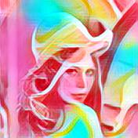
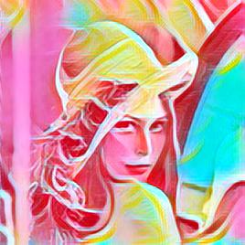
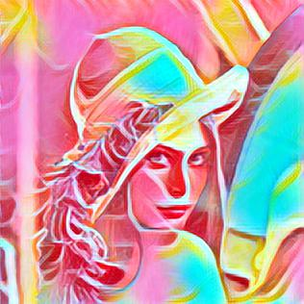
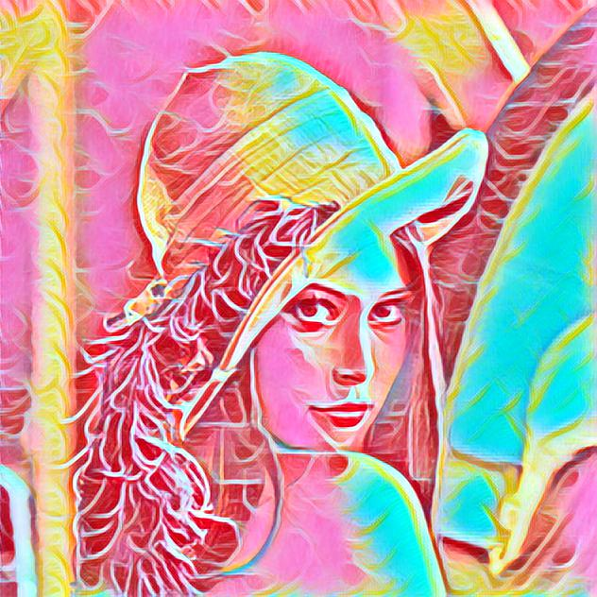
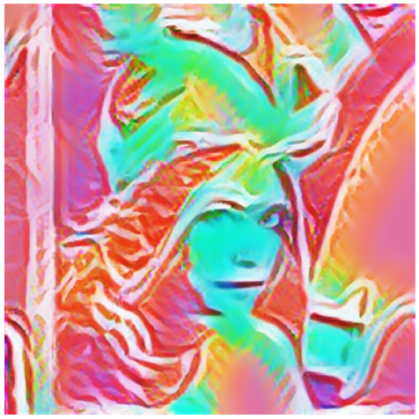
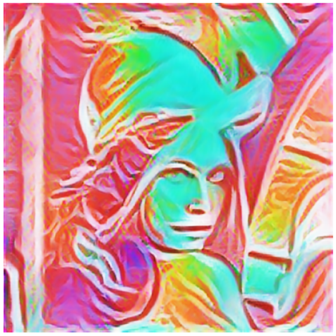
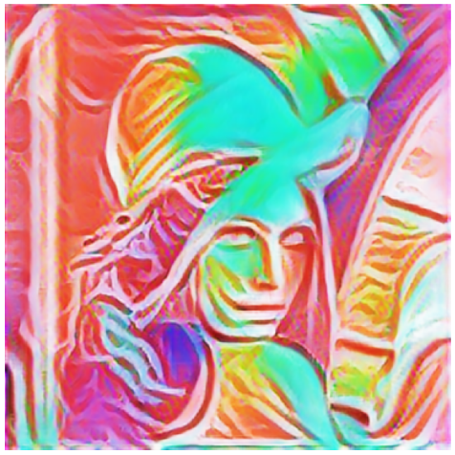

Comparison 1
Style
Content Weight
0.1 0.4 0.7 1
Input
Fei-Fei Li’s
Ours

Slide 83
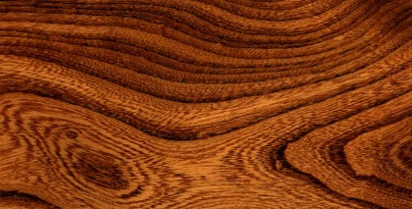
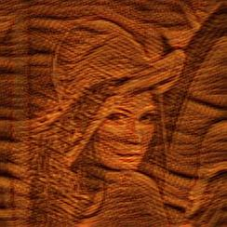
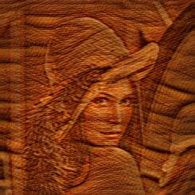
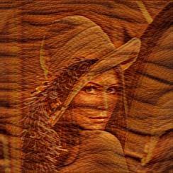
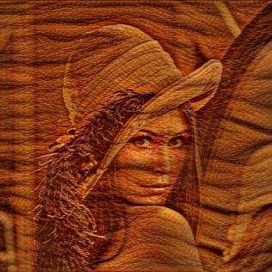
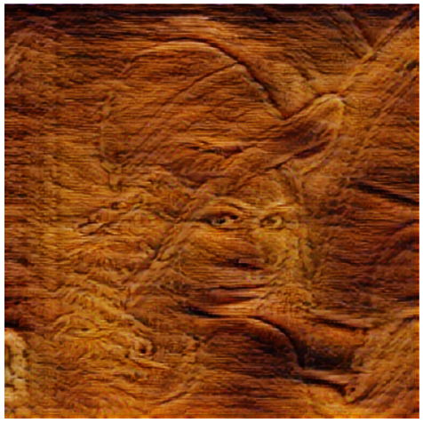
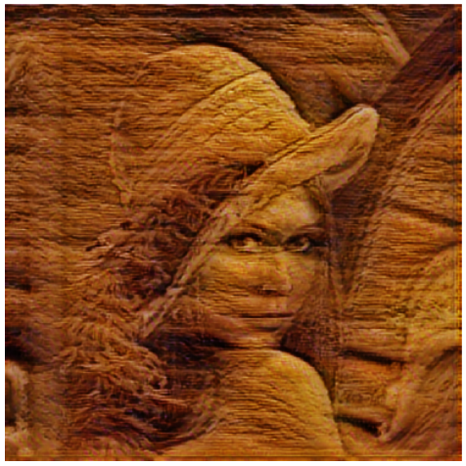
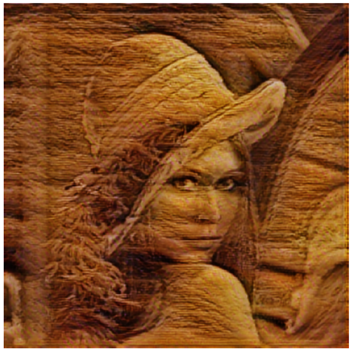
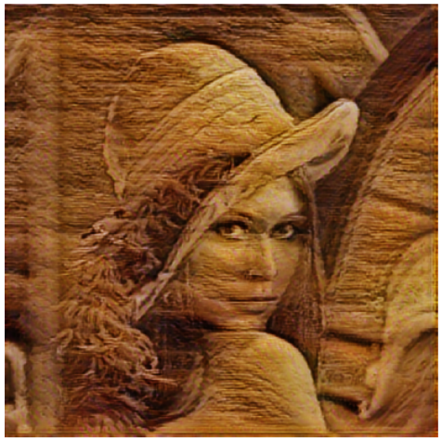
Comparison 2
Style
Content Weight
0.1 0.4 0.7 1
Input
Fei-Fei Li’s
Ours

Slide 84
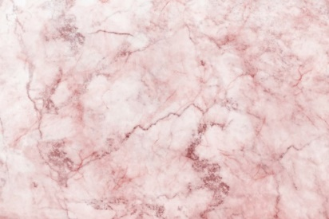
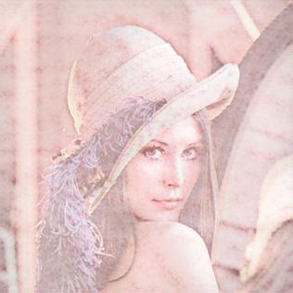
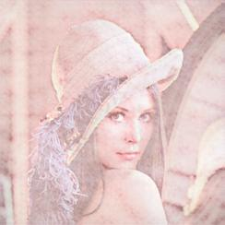
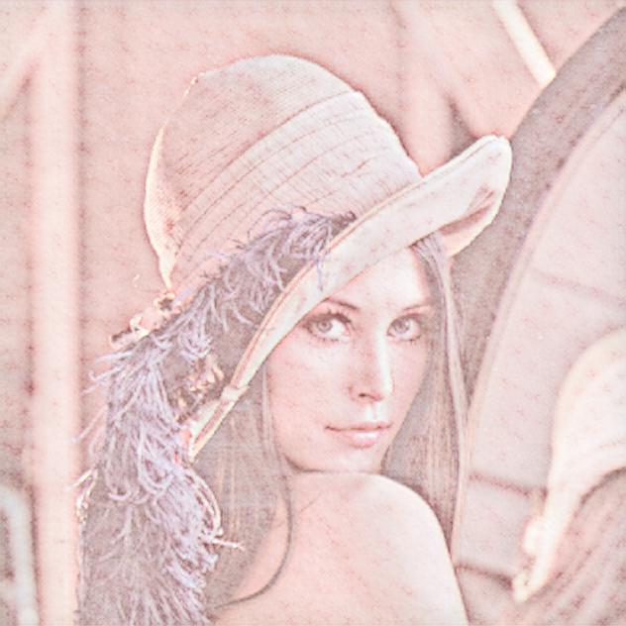
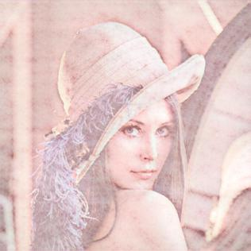
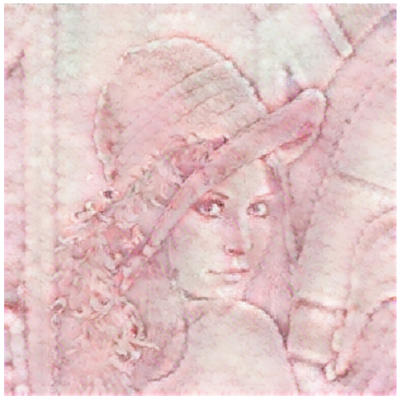
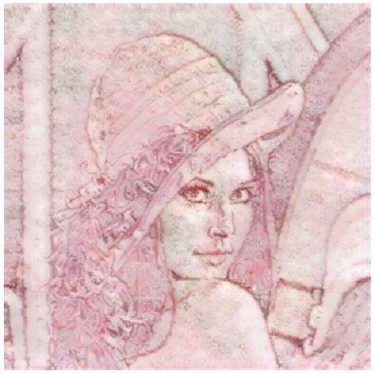
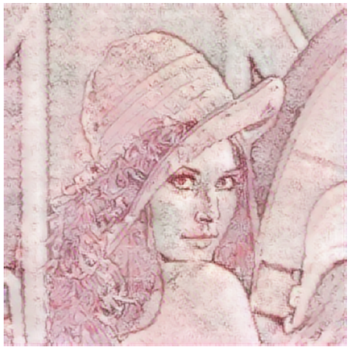
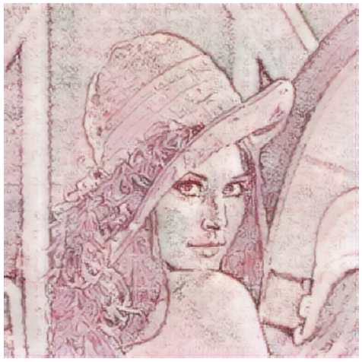
Comparison 3
Style
Content Weight
0.1 0.4 0.7 1
Input
Fei-Fei Li’s
Ours

Slide 85

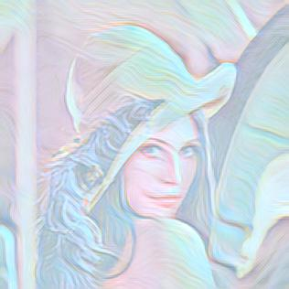
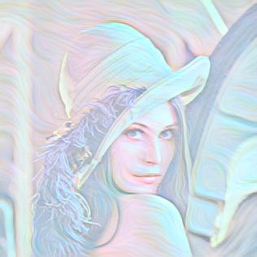
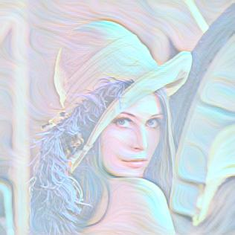
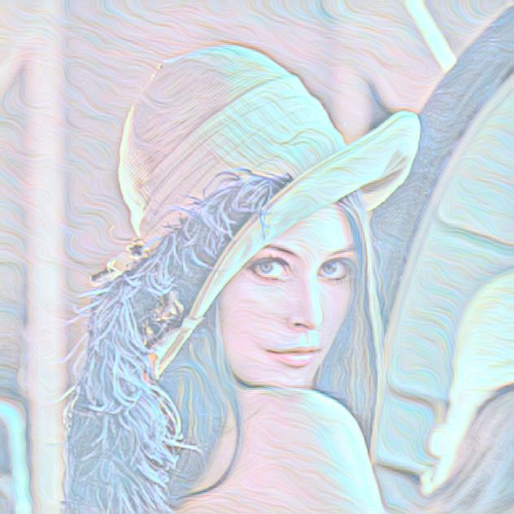
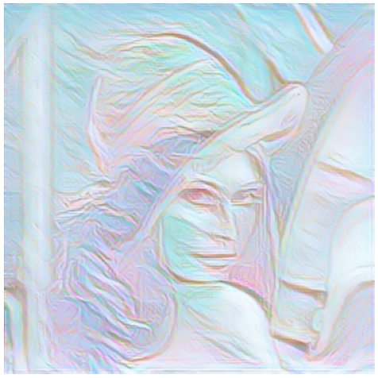
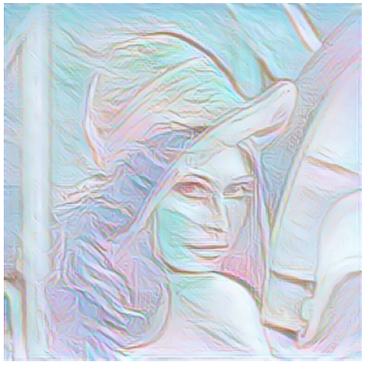
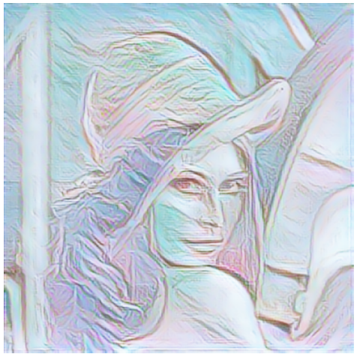
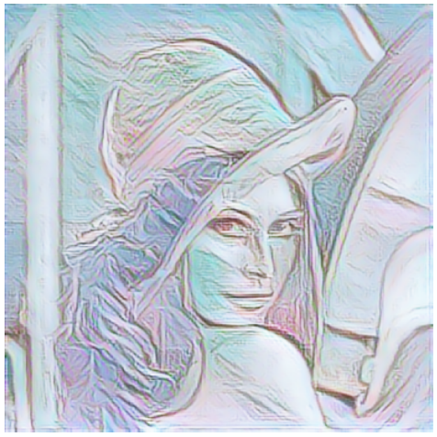
Comparison 4
Style
Content Weight
0.1 0.4 0.7 1
Input
Fei-Fei Li’s
Ours

Slide 86
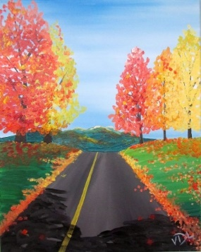
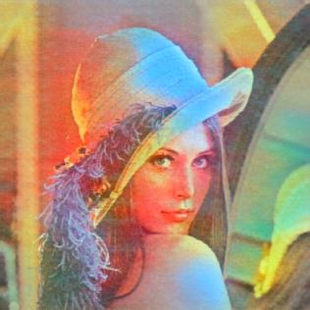
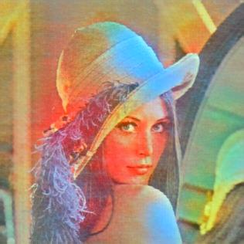






Comparison 5
Style
Content Weight
0.1 0.4 0.7 1
Input
Fei-Fei Li’s
Ours

Slide 87









Comparison 6
Style
Content Weight
0.1 0.4 0.7 1
Input
Fei-Fei Li’s
Ours

Slide 88









Comparison 7
Style
Content Weight
0.1 0.4 0.7 1
Input
Fei-Fei Li’s
Ours

Slide 89









Comparison 8
Style
Content Weight
0.1 0.4 0.7 1
Input
Fei-Fei Li’s
Ours

Slide 90









Comparison 9
Style
Content Weight
0.1 0.4 0.7 1
Input
Fei-Fei Li’s
Ours

Slide 91









Comparison 10
Style
Content Weight
0.1 0.4 0.7 1
Input
Fei-Fei Li’s
Ours

Slide 92










Comparison 11
Style
Content Weight
0.1 0.4 0.7 1
Input
Fei-Fei Li’s
Ours

Slide 93










Comparison 12
Style
Content Weight
0.1 0.4 0.7 1
Input
Fei-Fei Li’s
Ours

Slide 94










Comparison 13
Style
Content Weight
0.1 0.4 0.7 1
Input
Fei-Fei Li’s
Ours

Slide 95








Comparison 14
Style
Content Weight
0.1 0.4 0.7 1
Input
Fei-Fei Li’s
Ours

Slide 96








Comparison 15
Style
Content Weight
0.1 0.4 0.7 1
Input
Fei-Fei Li’s
Ours

Slide 97








Comparison 16
Style
Content Weight
0.1 0.4 0.7 1
Input
Fei-Fei Li’s
Ours

Slide 98









Comparison 17
Style
Content Weight
0.1 0.4 0.7 1
Input
Fei-Fei Li’s
Ours

Slide 99








Comparison 18
Style
Content Weight
0.1 0.4 0.7 1
Input
Fei-Fei Li’s
Ours

Slide 100








Comparison 19
Style
Content Weight
0.1 0.4 0.7 1
Input
Fei-Fei Li’s
Ours

Slide 101








Comparison 20
Style
Content Weight
0.1 0.4 0.7 1
Input
Fei-Fei Li’s
Ours

Slide 102








Comparison 21
Style
Content Weight
0.1 0.4 0.7 1
Input
Fei-Fei Li’s
Ours

Slide 103








Comparison 22
Style
Content Weight
0.1 0.4 0.7 1
Input
Fei-Fei Li’s
Ours

Slide 104









Comparison 23
Style
Content Weight
0.1 0.4 0.7 1
Input
Fei-Fei Li’s
Ours

Slide 105








Comparison 24
Style
Content Weight
0.1 0.4 0.7 1
Input
Fei-Fei Li’s
Ours

Slide 106








Comparison 25
Style
Content Weight
0.1 0.4 0.7 1
Input
Fei-Fei Li’s
Ours

Slide 107








Comparison 26
Style
Content Weight
0.1 0.4 0.7 1
Input
Fei-Fei Li’s
Ours

Slide 108








Comparison 27
Style
Content Weight
0.1 0.4 0.7 1
Input
Fei-Fei Li’s
Ours

Slide 109








Comparison 28
Style
Content Weight
0.1 0.4 0.7 1
Input
Fei-Fei Li’s
Ours

Slide 110
References
https://arxiv.org/pdf/1603.08155.pdf
https://upload.wikimedia.org/wikipedia/zh/3/34/Lenna.jpg
http://1.bp.blogspot.com/-qjEiZMIFSPM/Uq09aPXKLPI/AAAAAAAAALw/CNom8SFrINQ/s1600/avril_lavigne_goodbye_lullaby-wallpaper-3554x1999.jpg
https://cdn.pixabay.com/photo/2014/02/17/10/20/statue-of-liberty-267948__480.jpg
https://paulryan.com.au/wp-content/uploads/2015/01/high-resolution-wallpapers-25.jpg
https://www.easypeasyandfun.com/wp-content/uploads/2018/06/Acrylic-Painting-for-Beginners.jpg
https://www.greenorc.com/2019/12/easy-acrylic-abstract-painting-ideas/
https://www.istockphoto.com/vector/abstract-marble-swirls-background-gm1153304885-313186472

Slide 111
Thanks for Listening

